Slide 1
Stacks
LIFO Data Storage

Slide 2
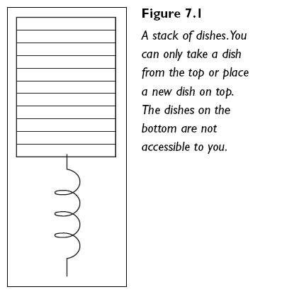
Introducing Stacks
  If you have ever been to a buffet restaurant you will have seen stacks in action
    When you approach a buffet you take the top plate from a stack of plates, then use it
    When kitchen staff clean a plate, they put it on top of the stack of plates ready to be used by the next customer
  This is exactly how a stack operates.

Slide 3
What makes a Stack?
  A Stack is a specific type of sequence: a linear end-point sequence
    Data is stored in linear sequence
    Data can only be accessed at one end point, the top
      This means data cannot be searched or amended within the sequence
  A Stack works as LIFO - Last In, First Out
    Last element to be added is the only thing you can currently access

Slide 4
Fundamental Operations for a Stack
  Stack is a greatly reduced/restricted form of list
  Stacks can only:
    Add an element to top of the stack (push)
    Remove the top element from the stack (pop)
    Check the element on top of the stack without removing it (peek)
    Count elements in stack
    Check if the stack is empty
    Check if the stack is full (Bounded variant only)

Slide 5
Stack ADT: A More Formal Definition
  push(e) Insert element e at top of the stack
    Input: Element to be added
    Output: None
  pop() Remove element from top of stack and return it. If stack is empty,
  an error should occur
    Input: None
    Output: Element
  peek() Retrieve element from top of stack and return it. This should NOT
  remove the element from the stack. If the stack is empty, an error
  should occur
    Input: None
    Output: Element

Slide 6
Stack ADT Continued
  size() Return the number of elements on the stack
    Input: None
    Output: Integer
  isEmpty() Return a boolean indicating if the stack is
  empty
    Input: None
    Output: True/False

Slide 7
Where to Use a Stack
  Tracking order of actions/processing in particular order
  To achieve a specific goal/complete a specific task (as a programmer)
  Common examples:
    Tracking actions in a game (to allow for undoing)
    Tracking pages visited in a browser (to allow for going back to previous page)
    Tracking method calls in a program
  Not used where you wish to:
    Search
    Add to the middle of the data
    Sort the data stored
Notes:
* This is implementation-dependant, one version of List (link-based) is extremely good at this, while another (array-based) is extremely bad at it.

Slide 8
Implementing the
Stack ADT
Arrays V.s. Linked Lists

Slide 9
Approaches to Stack Implementation
  Just like Lists, there are two main approaches to coding an implementation of a Stack ADT
    Array-based
    Pointer/Link-based (LinkedList)
  When implementing an array-based stack, track the index of the top of the stack
    I.e. what number slot did we insert into most recently?
      Insert into slot[size], then increase size
      Remove from slot[size-1], then decrease size
  When implementing a link-based stack, track the first node in the list
    Always add to and remove from the front of the list

Slide 10
Array-Based Implementation
  Two approaches within array-based implementation
    Basic arrays
    Dynamic arrays
  Basic arrays provide a bounded stack
    Only a certain amount of information can be stored
      Anything over this limit causes a stack overflow exception
    Unlike lists, this is a commonly allowed restriction for stacks
  Dynamic arrays provide an unbounded stack
    Any quantity of information can be stored – array will grow to accommodate it

Slide 11
The Down Side of Arrays
  Arrays require memory to be reserved in advance, even when we don’t have anything to store yet
  Consider this equation:
    Stack to hold 100 GameMoves
    Each GameMove requires 4 bytes for its memory address
    How much memory must be allocated as soon as the empty Stack is created?

Slide 12
Link-based Stacks
  Instead of allocating large chunk of memory in advance, we only allocate enough for:
    All the objects we have in the stack so far
    One more object to cover the next element to come (our next pointer)
  This is an over-simplication, as all objects are wrapped in Nodes
    Link-based stacks can actually cost more in memory when the data being stored is very small to begin with – why?

